Slide 1

Lecture 1
Introduction to Personal Computer
CT4005NI - Computer Hardware and Software Architectures

Slide 2
Lecture 01’s Objectives
What is Information Technology
Describe a computer System
Identify the name, purpose and Characteristics of:
Computer Cases
Power Supply Units
Color coding of power supply unit
Different types of motherboard form factor.

Slide 3

1.1 Information Technology
Information Technology is:
the design, development, implementation, support and management of computer hardware and software applications.
IT professional should have Knowledge of Computer System &
Operating System.

Slide 4
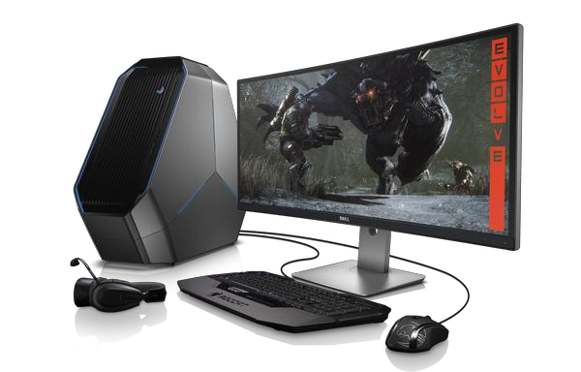
1.2 A Computer System
A computer system consists of hardware and software
components.
Hardware: case, storage drives, keyboards, monitors, cables, so forth.
Software: operating system and programs.
The operating system instructs the computer how to operate.
These operations may include identifying, accessing, and processing information.
Other Programs and Application performs different functions which they are assigned to.

Slide 5
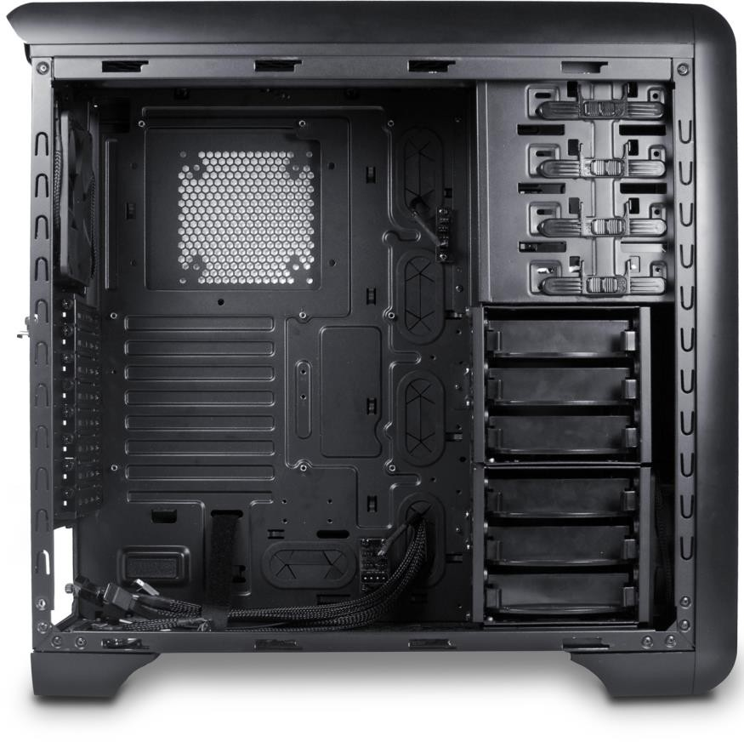
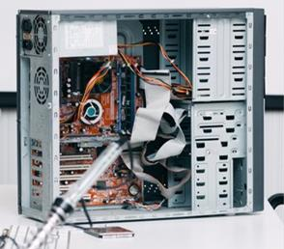
1.3 Computer Cases

Slide 6
1.3 Computer Cases and Power Supplies
A computer case contains the framework to support the internal components of a computer while providing an enclosure for added protection.
Computer cases are typically made of plastic, steel, and aluminum and are available in a variety of styles.
The size and layout of a case is called a form factor.
Cases are also referred as Computer chassis, Cabinet, Tower, Box, Housing.
Cases also provide an environment designed to keep the internal components
cool using Case Fans.
Further, cases help to prevent damage from static electricity as internal components of the computer are grounded by attachment to the case.

Slide 7
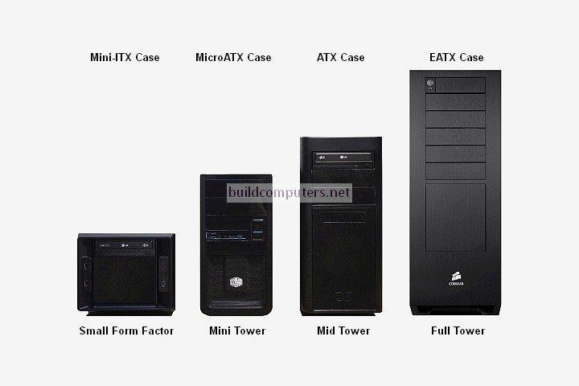
1.3 Computer Cases : form factor
The size and layout of a case is called a form factor.
Use motherboards & PSUs based on case form factor

Slide 8
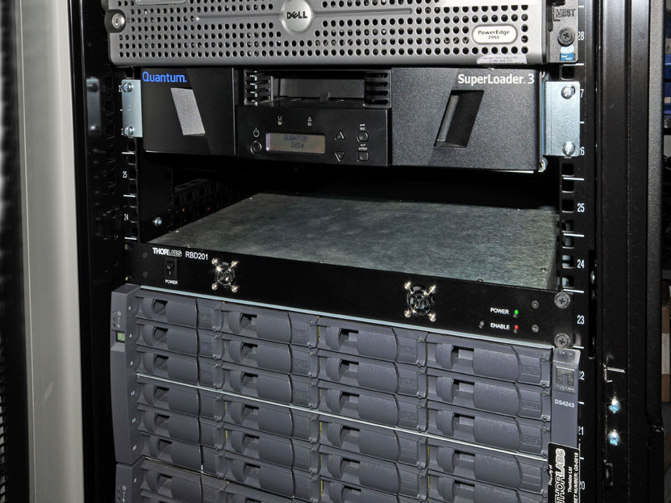
Rack Mounted PC A Rackmount Computer is a PC in varying sizes that is stored securely in an enclosure or a “rackmount cabinet”. This protects the computer from being damaged by outside sources or elements.

Slide 9
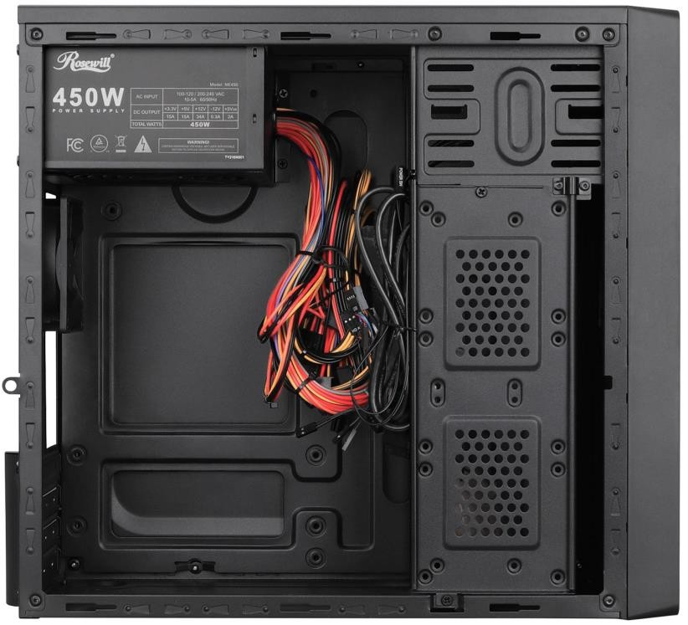
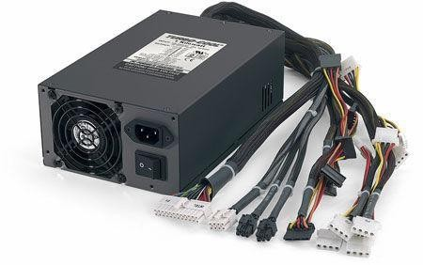
1.3 Power Supply Units : fixed
Power Supply Unit (PSU) converts alternating- current (AC) power coming from a wall outlet into direct-current (DC) power, which is a lower voltage.
The PSU must provide enough power for the currently installed components and for the components which may be added later.
Cables in fixed PSUs are not detachable

Slide 10
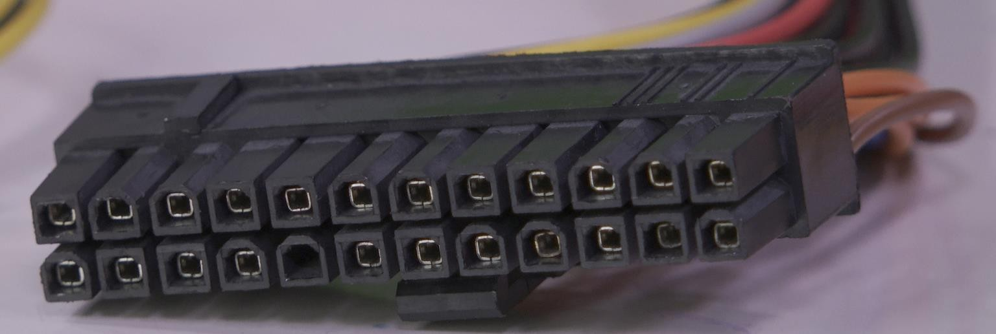
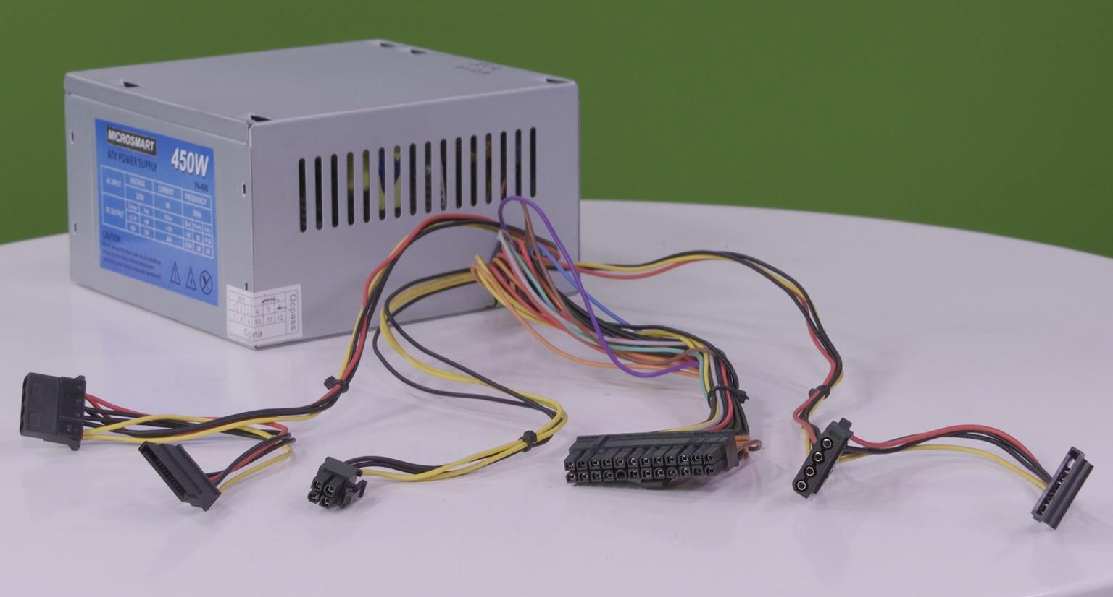
1.3 Power Supply Units : fixed
Connector in Power Supply
Most connectors today are keyed
connectors.
Keyed connectors are designed to
be inserted in only one direction.

Slide 11
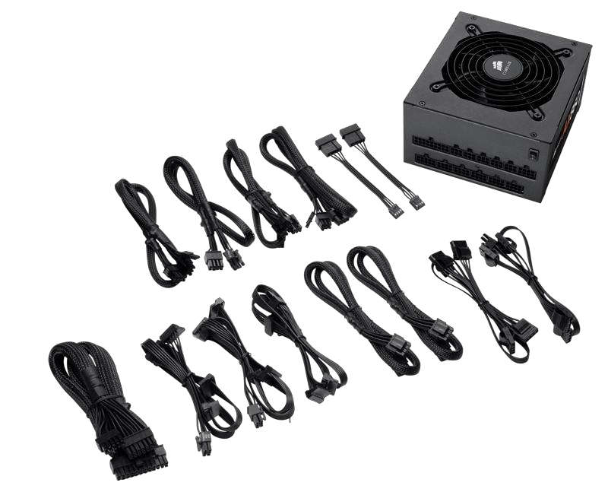
1.3 Power Supplies : Modular
They are PSUs that have all or some power cables which are detachable.
They are a good alternative for saving space inside the computer’s System Unit and for better cable management.
They are priced higher than its old counterparts.

Slide 12
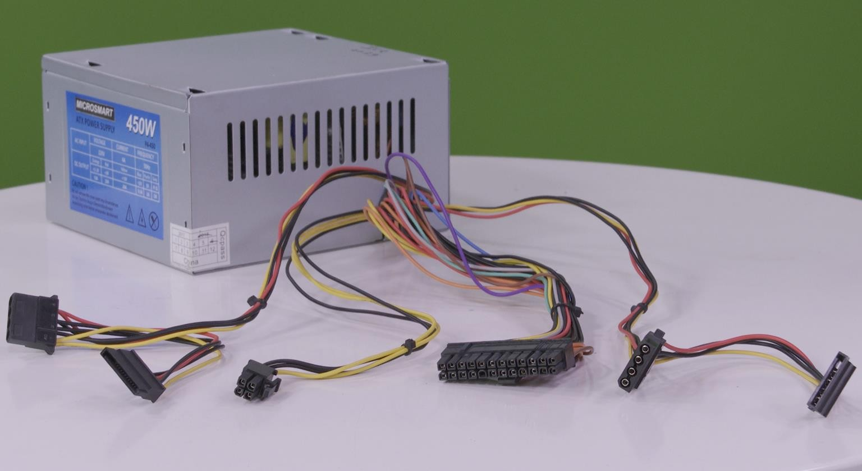
1.3 Power Supply Unit : connectors

Slide 13
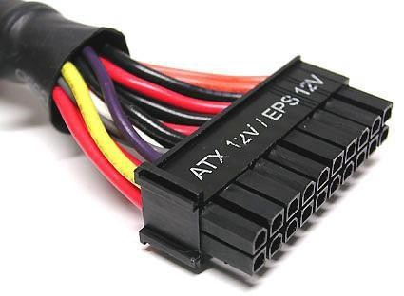
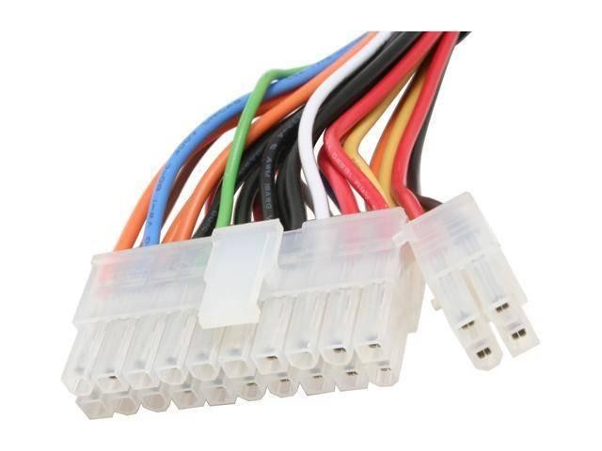
1.3 PSU connectors : Main
Connectors in Power Supply Units
P1 / 20 pin connector
Main power connector which provides power to almost all the motherboard components
P1 / 24 pin connector
Additional four pins are for backup to balance load when more components are added

Slide 14
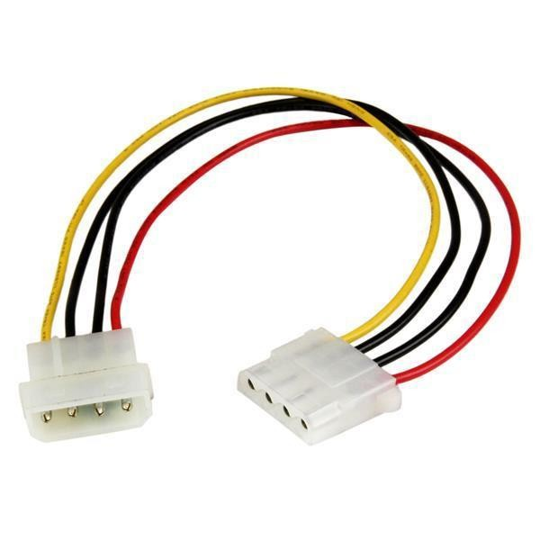
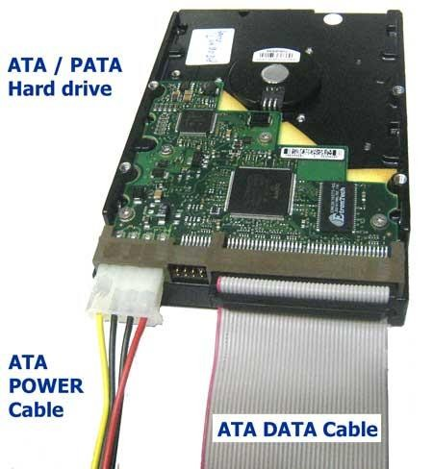
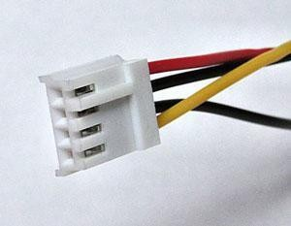
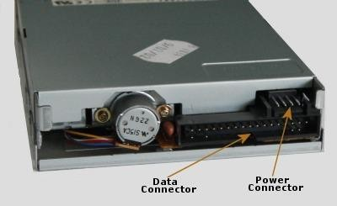
1.3 PSU Connector : Molex
Connectors in Power Supply Units
Molex connector (4-pin)
Used to power PATA hard disks
Mini-Molex / Berg Connector
(4-Pin)
Used to power floppy disks

Slide 15
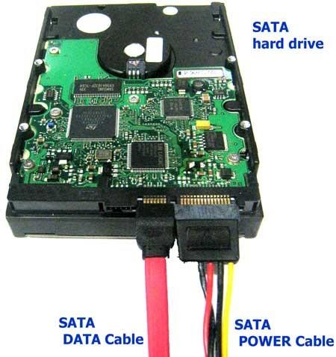
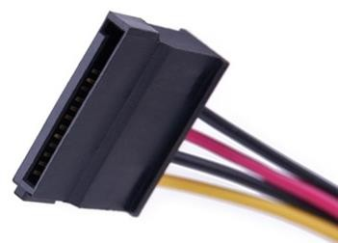
1.3 PSU connectors : SATA
Connectors in Power Supply Units
SATA power connector (15-Pin)
Used to power SATA hard disks and other SATA drives

Slide 16
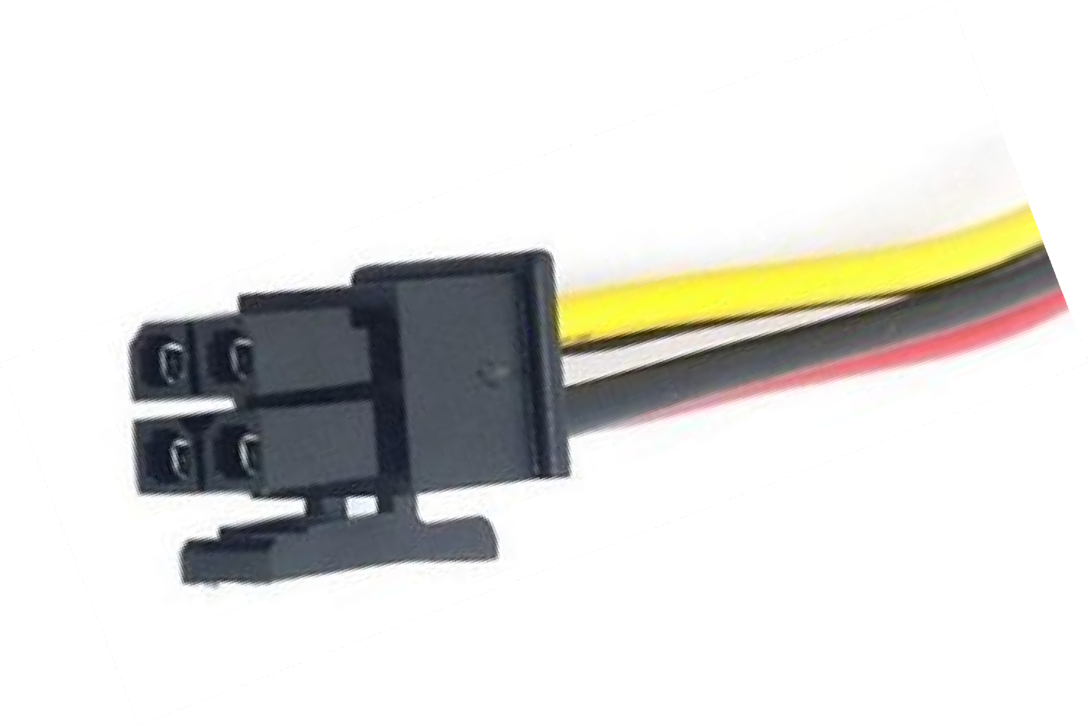
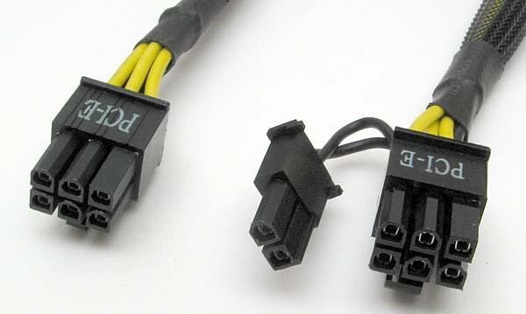
1.3 PSU connectors : PCIe & power
Connectors in Power Supply Units
Power connector (4 pin)
Used to power processor voltage regulator
PCI-E Connectors (6 pin and 8 pin)
Powers PCI-E cards

Slide 17
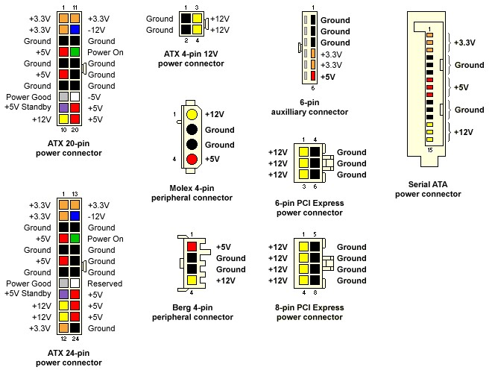
1.3 PSU connectors : color coding

Slide 18
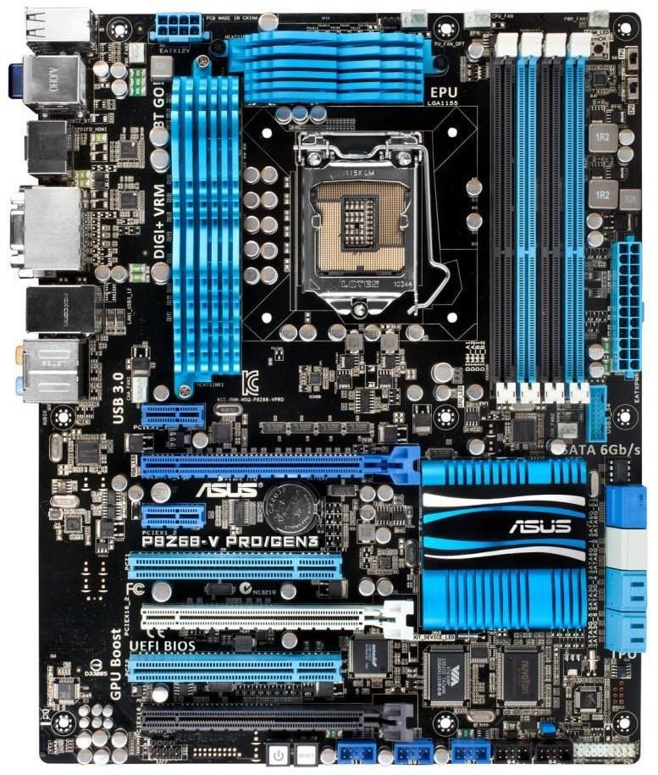
1.4 Internal Components : Motherboard
The motherboard is the main Printed Circuit Board (PCB) and contains the buses, or electrical pathways, found in a computer.
A motherboard is also known as the system board, the backplane, or the main board.
The motherboard consists of the central processing unit (CPU) socket, RAM slots,
expansion slots, heat sink/fan assembly, BIOS chip, chipsets, I/Os and so forth.

Slide 19
1.4 Motherboard form factors
 | Mini ITX | Micro ATX | ATX
Maximum Size | 6.7 x 6.7 (inch) | 9.6 x 9.6 (inch) | 12 x 9.6 (inch)
RAM Slots | 2 | 2 to 4 | 2 to 8
RAM Type | DIMM, SODIMM | DIMM | DIMM
Expansion Slots | 1 | 2 to 4 | 4 to 7
Graphics Cards | 0 to 1 | 1 to 3 | 1 to 4
SATA Ports | 2 to 6 | 4 to 8 | 4 to 12

Slide 20
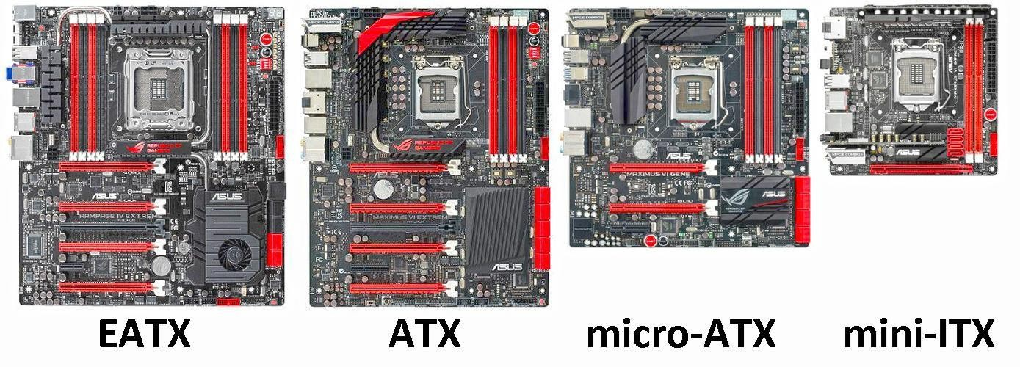
1.4 Common Motherboard form factors

Slide 21
1.4 Internal Components : motherboard
The most common form factor in desktop computers was the AT, based on the IBM AT motherboard.
A newer motherboard form factor, ATX, improved on the AT design.
The chipset is an important set of components of the motherboard that consist of various IC and controls how system interacts with CPU and board.
Most chipsets are divided into two distinct components, Northbridge and
Southbridge. There workings varies from manufacturer to manufacturer.

Slide 22
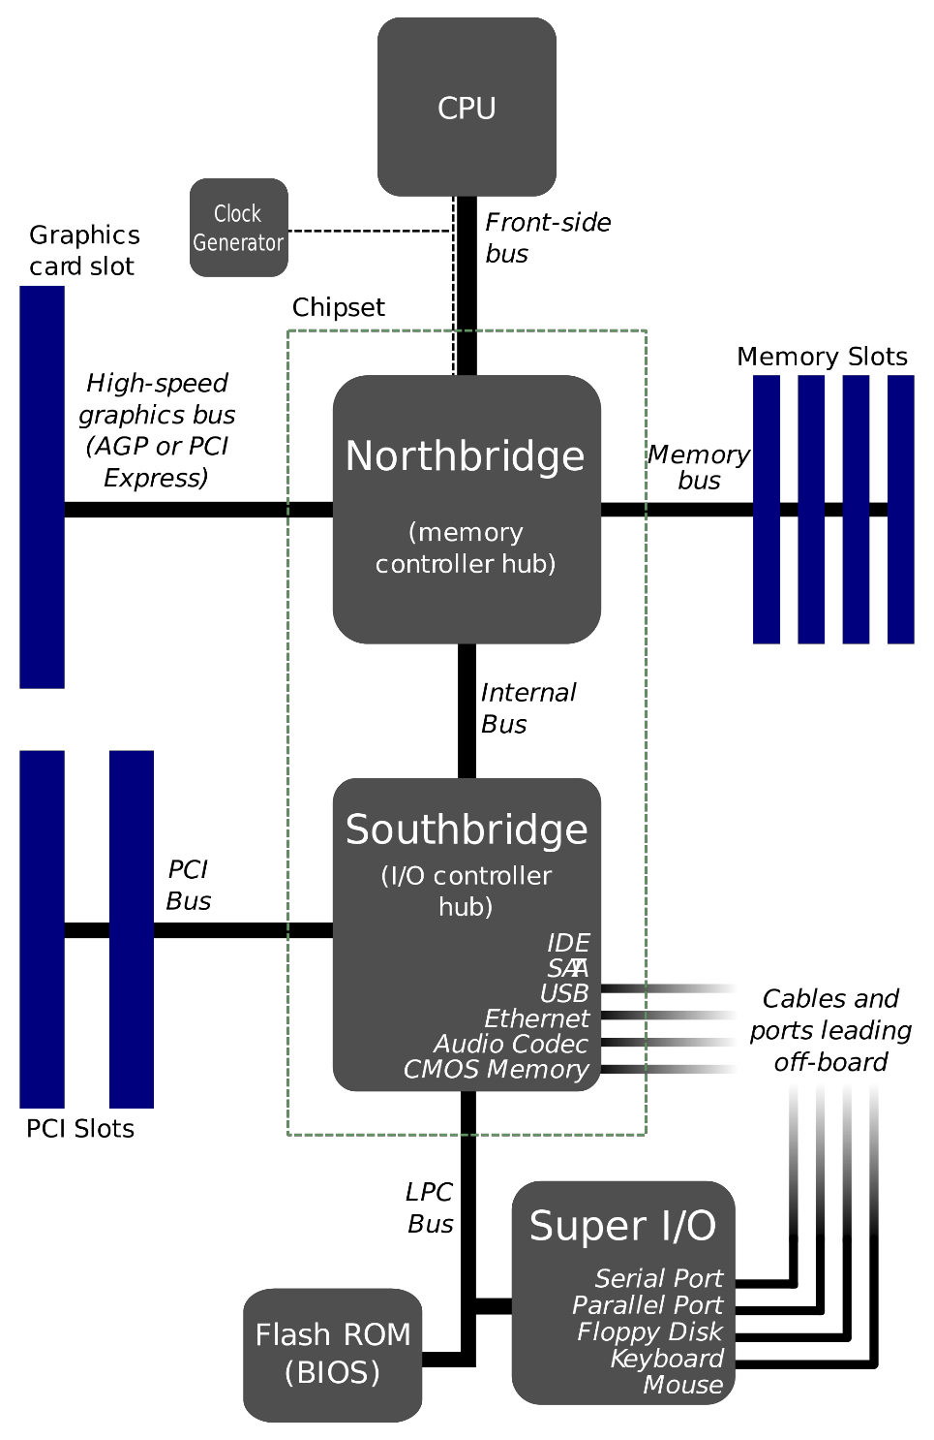
1.4 Internal Components contd.
In general, the Northbridge controls access to the RAM, video card, and the speeds at which the CPU can communicate with them.
The Southbridge, in most cases, allows the CPU to communicate with the hard drives, sound card, USB ports, and other I/O ports.

Slide 23
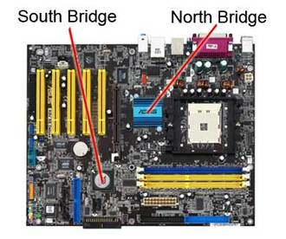
Northbridge and Southbridge

Slide 24

End of Lecture for week 1
Any question ?

Slide 25
End of Lecture for week 1
Thank you ! Have a nice day.

